Slide 1




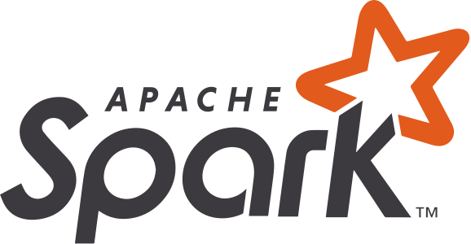





IBM WATSONX.DATA · WORKSHOP
One Lakehouse, Four Paths to the Medallion
dbt · Spark · DataStage · Confluent — Bronze → Silver → Gold on Apache Iceberg
Alexander Seelert · IBM Customer Success Engineer
watsonx.data 5.3 · 2026

Slide 2
SESSION PREP
What We’ll Cover — and Why It Matters
• The medallion pattern (Bronze → Silver → Gold) — why nearly every serious lakehouse is built this way
• Four ways to build it on watsonx.data:
– dbt — SQL-first, free & open source
– Spark — Python, ML-ready, two engine flavors
– DataStage — no-code, governed, visual ETL
– Confluent — Kafka + Flink, event-driven streaming
• Why Databricks and Snowflake are both racing toward event-driven ingestion right now — and how Confluent Tableflow already does it
• Orchestration: open-source Airflow, and IBM’s OEM partnership with Astronomer
• A side-by-side comparison so you can pick the right tool for your team
watsonx.data — Medallion Lakehouse
02 / 20

Slide 3
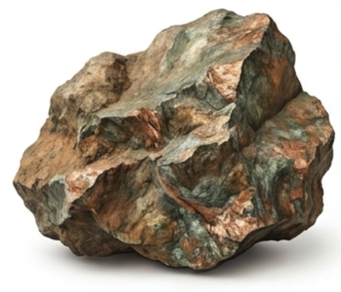


FOUNDATIONS
Why Bronze → Silver → Gold?
What is a Medallion Layer
it's just a naming convention for organizing ordinary tables into three quality stages.
BRONZE
Losless replication of source data, Land the truth, unmodified & replayable
Used for later Rebuilds new Process Chains Query Optimized by Partitioning
The problem without Medallion Layer
• Raw source data is messy, duplicated, and ungoverned
• BI dashboards and ML models cannot trust it directly
• Every team re-invents its own cleaning logic — numbers disagree
• The medallion pattern gives every layer one job, and one owner
SILVER
Clean, conformed, joined — one shared definition of “an order” Join Multiple Tabels into one, full cleaned and enriched Table.
GOLD
Business-ready aggregates — the numbers everyone reports from Use Silver tables and Create Gold tables which are Aggregated (Sum) or Views
Each layer is a physical or logical Apache Iceberg table on open object storage — no vendor lock-in.
watsonx.data — Medallion Lakehouse
03 / 20

Slide 4
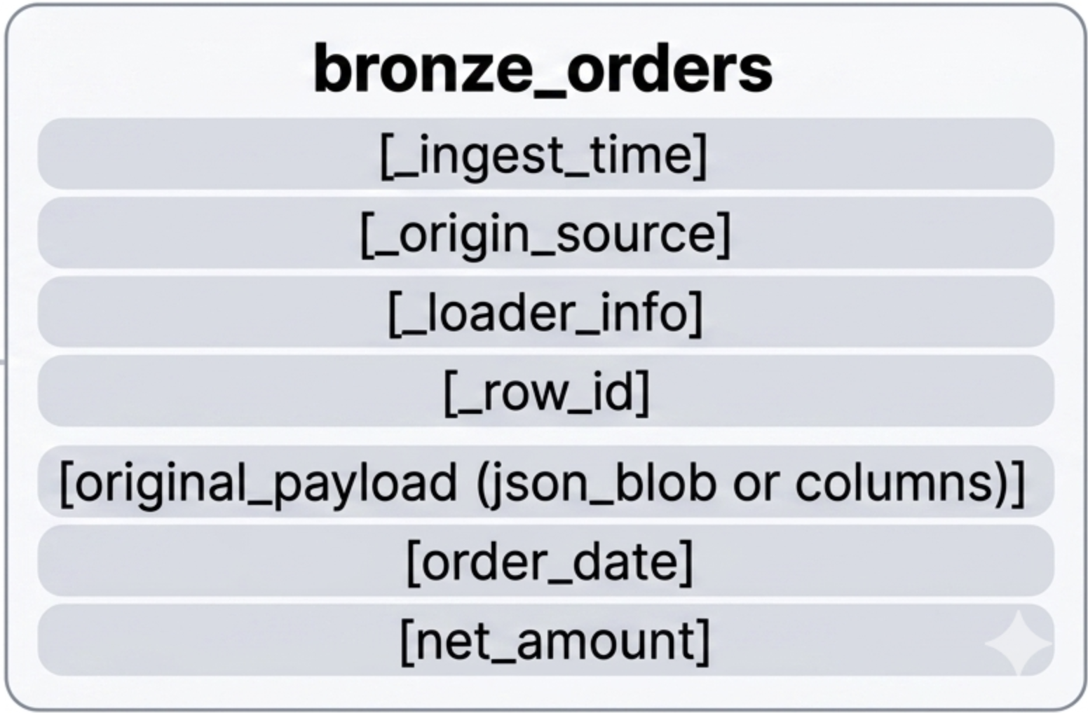
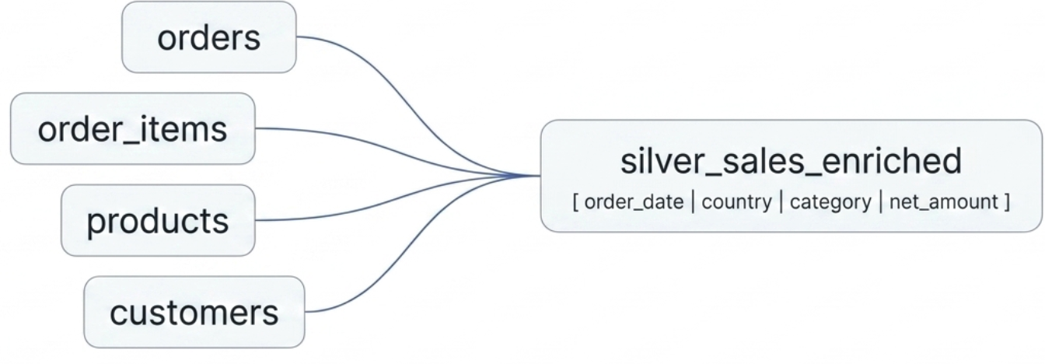
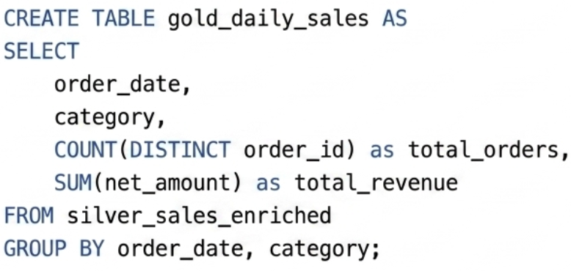
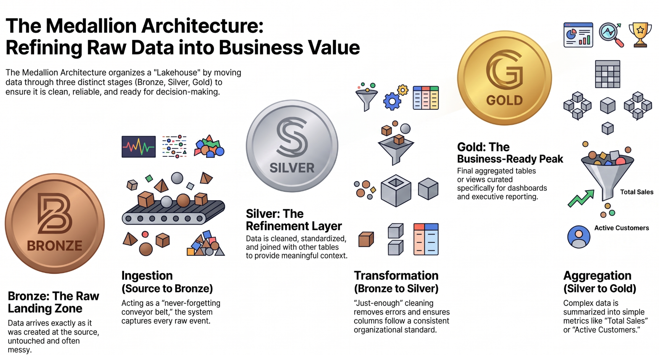
ARCHITECTURE
The Medallion Pattern on an Iceberg Lakehouse
SOURCES
→
BRONZE
→
SILVER
→
GOLD
→
CONSUMERS
CSVs · DBs · events
raw, as-is, replayable, history, full truth
clean · conformed · joined
aggregated business marts
BI · ML · apps
ALL THREE LAYERS LIVE IN ONE PLACE
• Apache Iceberg tables, Parquet format, on S3 object storage — one shared catalog (e.g. iceberg_data)
• Storage and compute are decoupled — Presto, Spark can all read or write the same tables, at the same time
watsonx.data — Medallion Lakehouse
04 / 20

Slide 5
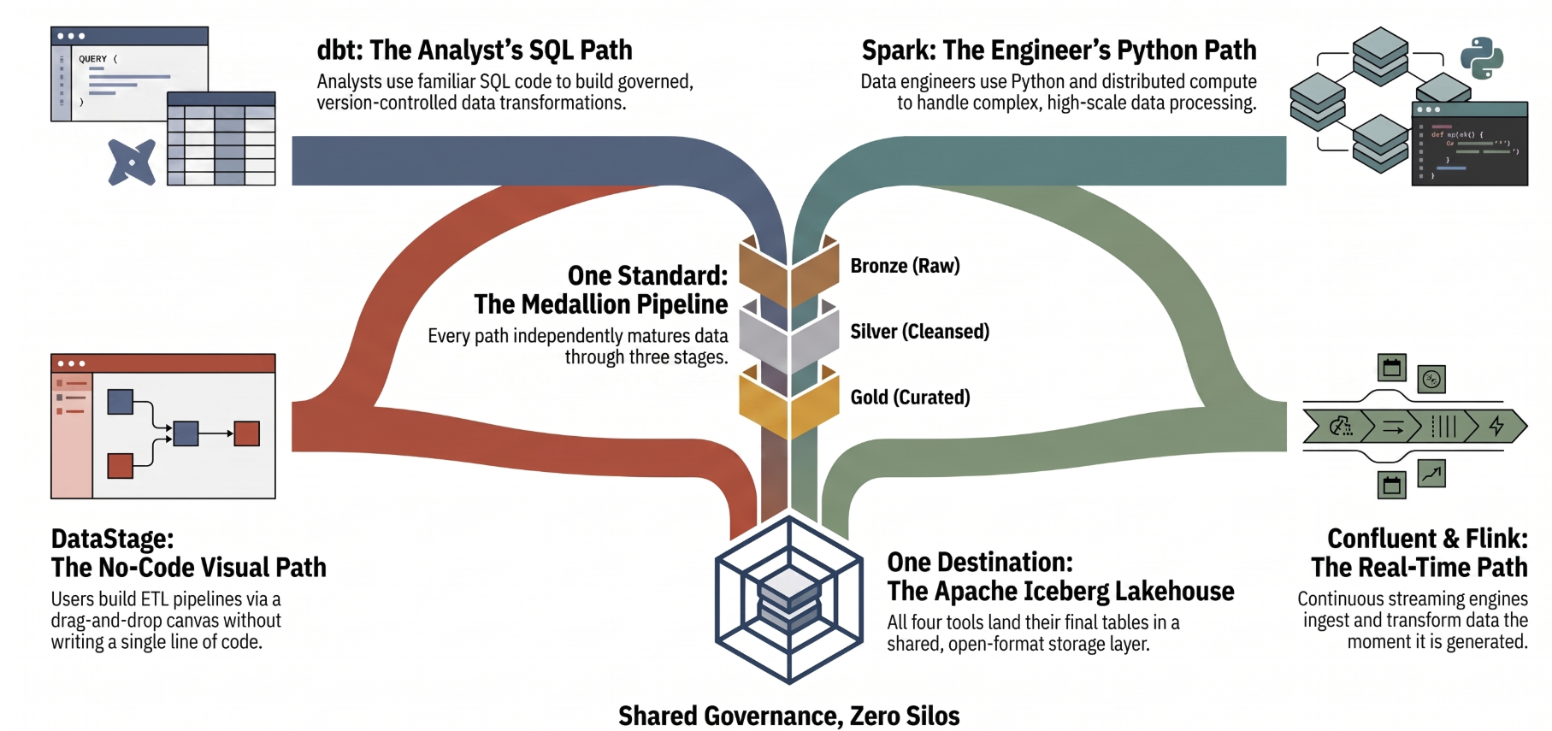
PLATFORM
watsonx.data: One Catalog, Many Engines/Tools
dbt
Spark (Gluten)
batch
ETL + ML
Iceberg Catalog
iceberg_data · Parquet · S3
DataStage
Flink & Kafka
No-code/Low Code ETL
Streaming
watsonx.data — Medallion Lakehouse
05 / 20

Slide 6
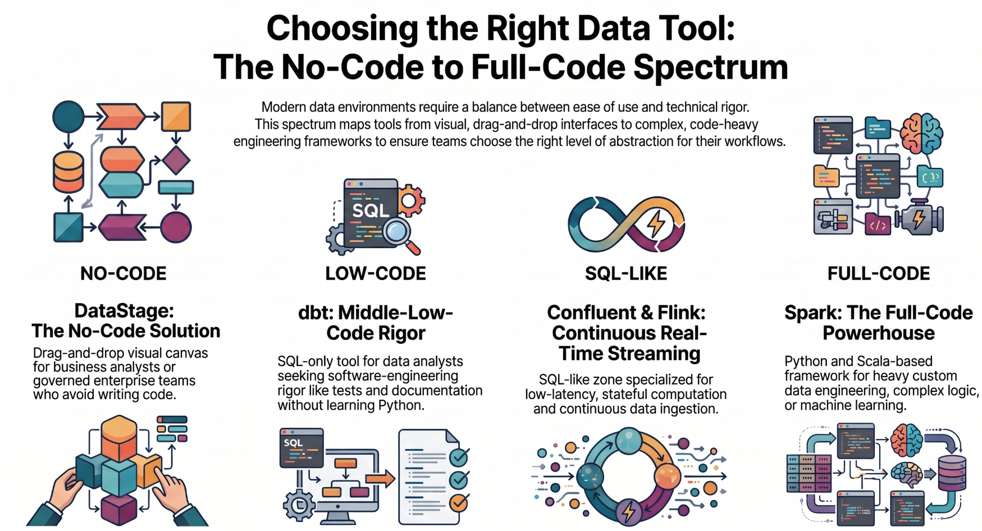
THE FOUR PATHS
Identical Gold Marts
Four Ways In, One Medallion Out
— same rows, same totals
dbt
Spark
batch
batch
SQL
Python
Confluent
DataStage
streaming
batch
Streaming
No-Code
Proven by row-level reconciliation across all three full pipelines — pick the tool that fits the team, not the other way around.
watsonx.data — Medallion Lakehouse
06 / 20

Slide 7
PATH A — DBT
SQL-First, Free & Open Source
• dbt Core is Apache 2.0 licensed — completely free, no seat cost
– dbt Cloud (managed CI/CD, scheduling, IDE) is the optional paid layer on top
• June 2026: the Rust-based “dbt Fusion” engine was folded into dbt Core as “dbt Core v2” — still fully open source
• IBM invests directly in the dbt ecosystem — three official adapters:
– dbt-watsonx-presto — what this project uses; table/view materializations, compute pushed to Presto
– dbt-watsonx-spark — run dbt transformations directly on the watsonx.data Spark engine
– db2-dbt — new (Apache 2.0) — dbt now reaches Db2 on IBM platforms too
• Compute is pushed down: dbt only compiles + orchestrates SQL — nothing runs on your laptop
• Only Transformation • Semantic meaning must be build manually
watsonx.data — Medallion Lakehouse
07 / 20

Slide 8
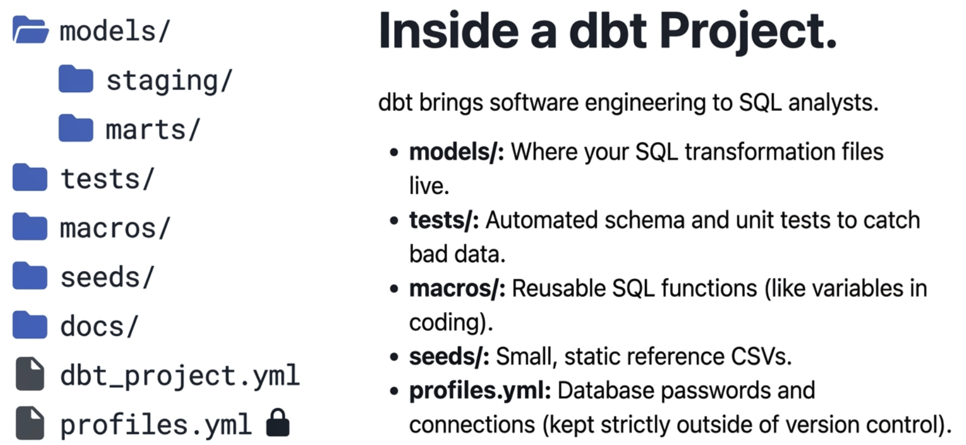
PATH A — DBT
A dbt Project
watsonx.data — Medallion Lakehouse
08 / 20

Slide 9
PATH A — DBT
Anatomy of a dbt Project
$ tree — this repo’s dbt project
Bronze — land it as-is
dbt_project.yml
models/
bronze/
bronze_orders.sql
bronze_sources.yml
silver/
silver_sales_enriched.sql
schema.yml
gold/
gold_daily_sales.sql
schema.yml
seeds/
raw_orders.csv (+3 more)
macros/
generate_schema_name.sql
-- models/bronze/bronze_orders.sql
select
order_id, customer_id, order_ts, status,
payment_method, current_timestamp as _ingested_at
from {{ ref('raw_orders') }}
Gold — the business aggregate
-- models/gold/gold_daily_sales.sql
{{ config(materialized='table',
properties={'format': "'PARQUET'"}) }}
select order_date, category,
count(distinct order_id) as order_count,
sum(net_amount) as net_revenue
from {{ ref('silver_sales_enriched') }}
where status = 'completed' group by 1, 2
watsonx.data — Medallion Lakehouse
08 / 20

Slide 10
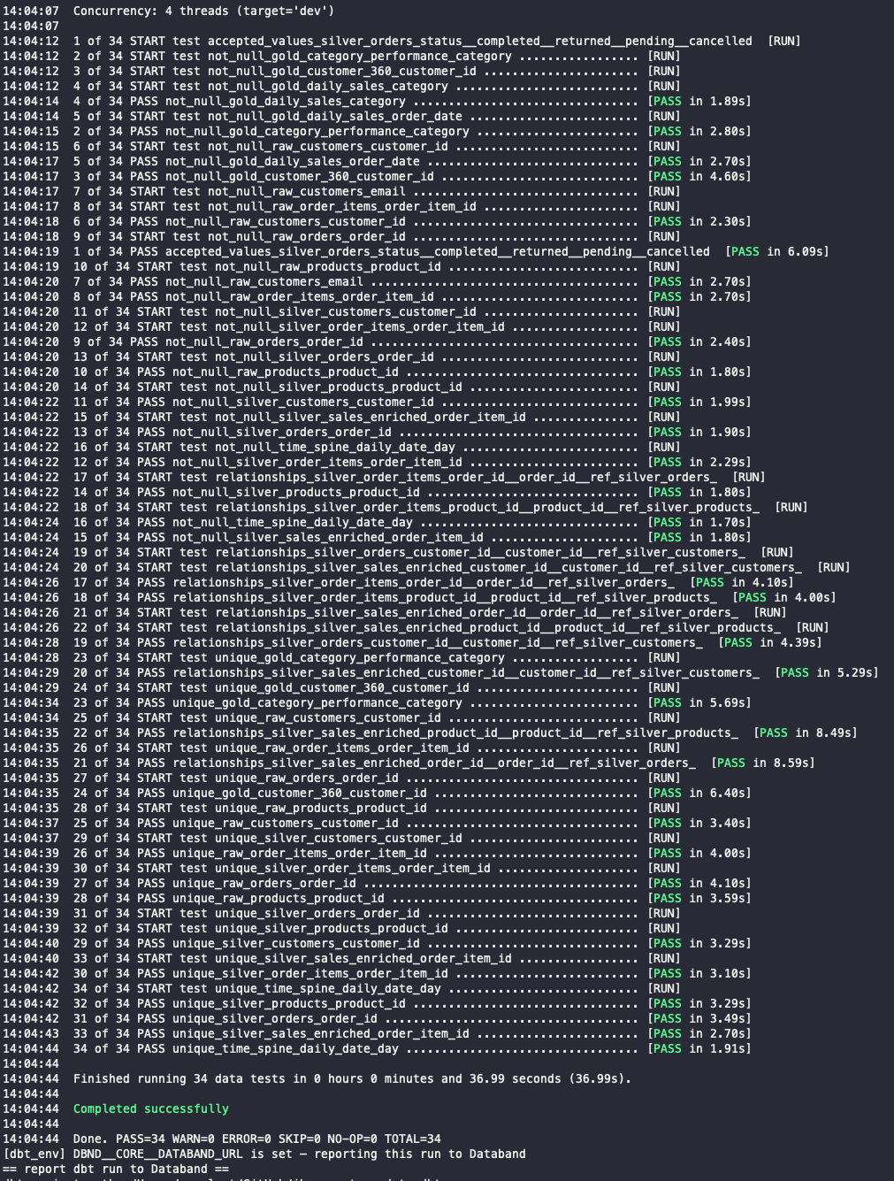
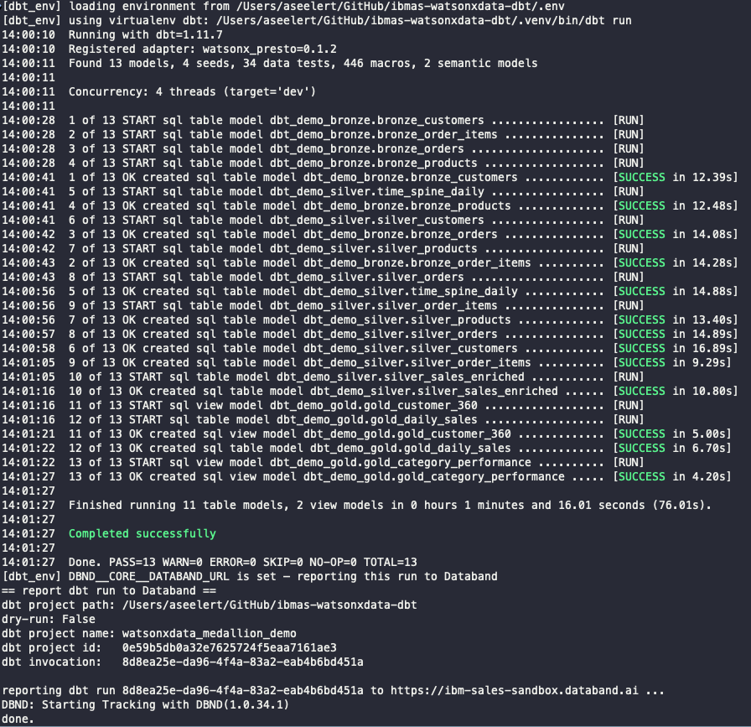
PATH A — DBT
dbt run and test example
watsonx.data — Medallion Lakehouse
08 / 20

Slide 11
PATH B — SPARK
Two Engines, One API
Spark (Java)
Apache Gluten-Accelerated Spark
GA
• Traditional JVM execution — the classic open-source Spark engine
• Full ecosystem compatibility, general-purpose default
• Data already landed in Object Storage (as csv, parquet, json, …)
• Offloads SparkSQL execution to Velox (open-source C++ engine — Meta / Uber / Intel / IBM)
• Fully API-compatible — no code changes to your PySpark jobs
• Lower cost per query; hash-joins by default
SAME VELOX SUBSTRATE, ACROSS ENGINES
• Presto C++ (Prestissimo) shares the same Velox core — GA, ~2–3× over Presto Java
• Gluten’s own 2023 benchmark: workload-dependent speedups (directional, not a current-day SLA)
• GPU acceleration for Presto C++ (NVIDIA cuDF) is a PRIVATE TECHNICAL PREVIEW — not GA, not a “Premium” SKU
watsonx.data — Medallion Lakehouse
09 / 20

Slide 12
PATH B — USE CASES
When to Reach for Spark vs. Presto
Spark — build & train
Presto — ask & report
PySpark, Python-first
Federated interactive SQL
• ML feature engineering at scale — windowing, aggregations across billions of rows
• MLlib pipelines — train and score models directly against Iceberg tables
• Custom Python / pandas UDFs for logic SQL can’t express
• Messy or semi-structured parsing (JSON, nested, multi-format)
• Structured Streaming for continuous batch-style jobs
• Ad-hoc, governed SQL over the same Iceberg tables — no cluster to spin up
• BI tool connectivity via JDBC / ODBC — Cognos, Power BI, Tableau
• Sub-second to low-second latency for dashboards and analysts
• One federated query surface across every engine’s output
• Prestissimo (Presto C++) — GA, ~2–3× faster than Presto Java
Same Iceberg tables, two access patterns: engineer features in Spark, then query and report in Presto.
watsonx.data — Medallion Lakehouse
10 / 20

Slide 13
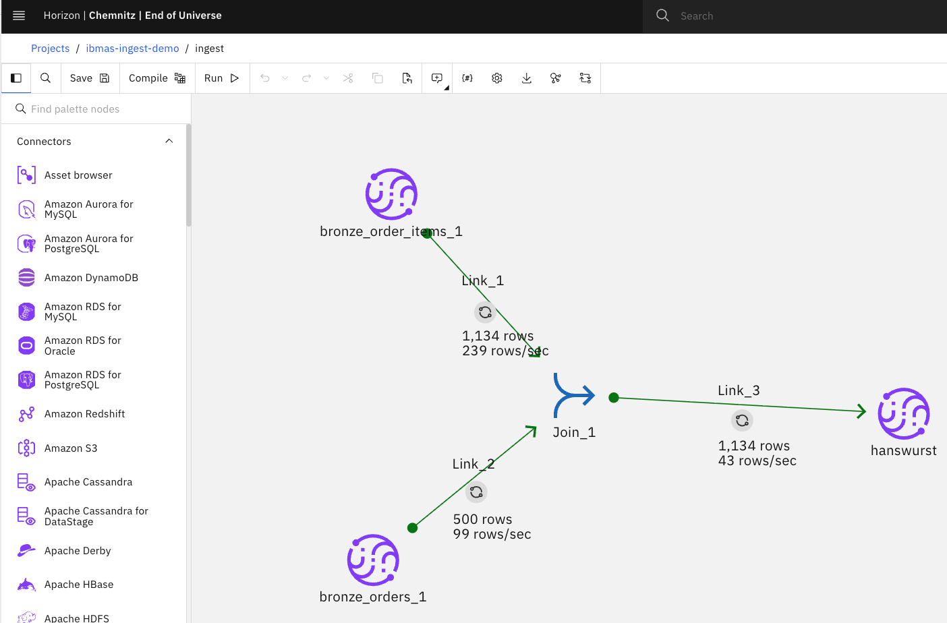
PATH C — DATASTAGE
No-Code, Governed ETL
• Visual canvas — build bronze → silver → gold with zero SQL or Python
• Talks to watsonx.data through the lakehouse connector — SQL pushdown straight to the Presto engine
– read_mode: select + select_statement on the source side
– table_action: replace on the target side
• Built entirely via REST API in this project — no DataStage SDK required; flows are created as CAMS assets in a Cloud Pak for Data project
• Part of watsonx.data Integration — alongside StreamSets, Data Replication (CDC), UDI, and Databand observability
• Proven in this project: DataStage flows reproduce the exact same 13 dbt models — gold sums match to the cent
Best for teams that standardize on a governed, audited, visual ETL tool — the business logic is identical to dbt/Spark, just no code to read.
watsonx.data — Medallion Lakehouse
11 / 20

Slide 14
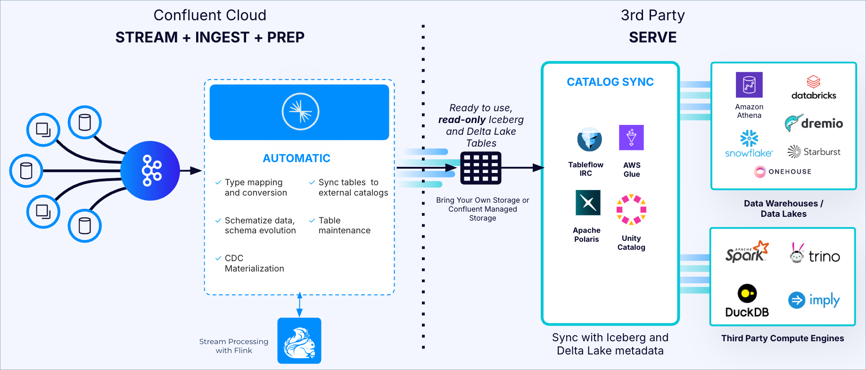
PATH D — CONFLUENT
Streaming, Not Batch
Producer
→
→
→
→
Gold Engine
CSV/DB rows → Avro
Kafka Topics
Apache Flink
Iceberg Sink
Spark or DataStage
governed by Schema Registry
continuous SQL, 9 jobs
watsonx.data catalog
• Bronze becomes a replayable event log (Kafka topic), not a static table — rewind and reprocess anytime
• Schema Registry (Avro) is streaming’s version of dbt tests — a bad message is rejected at the gate, not discovered downstream
• Silver updates seconds after data happens — not on tomorrow’s batch schedule
• Same destination as dbt and Spark: identical confluent_demo_gold marts, reconciled row-for-row
watsonx.data — Medallion Lakehouse
12 / 20

Slide 15
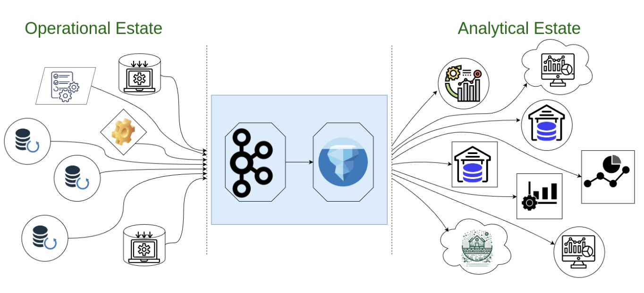
PATH D — CONFLUENT
Tableflow: Kafka Topics Become Tables — Zero ETL
• GA March 2025 for Iceberg; GA October 2025 for Delta Lake / Databricks Unity Catalog
• One checkbox on a topic — automatic schematization, type conversion, schema evolution, file compaction, catalog publishing
• Queryable by any engine — Snowflake, Databricks, BigQuery, Trino/Presto — without copying data
• In Confluent’s own words: Flink output is “the equivalent of Silver level data… mapped into Gold level data products”
• Confluent Cloud only — no on-prem availability
THIS WORKSHOP’S TAKE
We demonstrate the same pattern self-hosted: Kafka (KRaft) + Schema Registry + 9 Flink SQL jobs + a self-hosted Iceberg REST catalog + register_table into the watsonx.data catalog — Tableflow automates exactly this on Confluent Cloud.
watsonx.data — Medallion Lakehouse
13 / 20

Slide 16
INDUSTRY TREND
Batch Is No Longer the Default — Even for Databricks & Snowflake
Databricks Lakeflow
Snowflake Openflow
• Lakeflow Connect — 100+ managed connectors, incl. streaming / message-bus sources
• Real-Time Mode (Public Preview) — end-to-end latency as low as ~5ms for fraud detection, personalization
• Zerobus Ingest — no message bus needed, writes land in under 5 seconds
• Built on open-source Apache NiFi (from the 2024 Datavolo acquisition) — GA 2025 on AWS BYOC
• Openflow Connector for Kafka — reads topics directly into Snowflake tables
• Redesigned Snowpipe Streaming — vendor-reported up to 10 GB/s, ~5-second latency
The two biggest cloud data warehouses are both racing toward the same Kafka-native, low-latency pattern this workshop’s Confluent path already runs today.
watsonx.data — Medallion Lakehouse
14 / 20

Slide 17
HOW IT WORKS
Batch vs. Event-Driven, Mechanically
BATCH
Scheduled trigger
→
Full or incremental
→
Transform
→
Write —
(cron / hourly / nightly)
table scan
(SQL / PySpark)
then stop
dbt · Spark · DataStage — reacts on the next scheduled run
EVENT-DRIVEN
CDC or native
→
Durable log
→
Stream processor
→
Continuous sink,
producer emits a row example: IBM Infosphere Data Replication
(Kafka topic) retention 7 days (example)
(Flink) SQL transformation
exactly-once
Confluent · Openflow · Lakeflow — reacts within seconds of the source row changing
CDC = reading the database’s transaction log instead of polling tables. Exactly-once = idempotent producers + transactional writes + offset commits tied to the sink write.
watsonx.data — Medallion Lakehouse
15 / 20

Slide 18
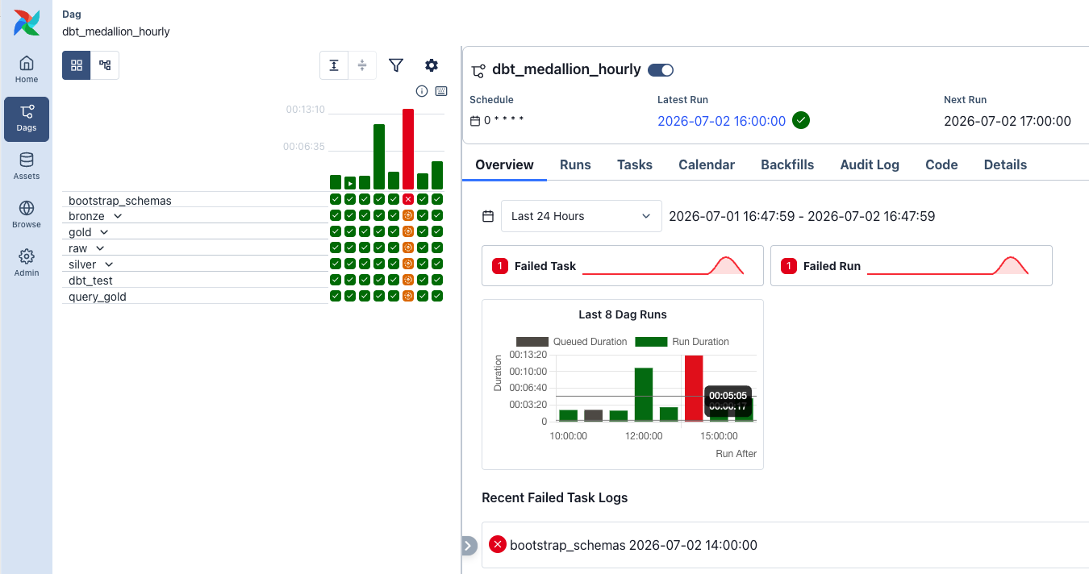

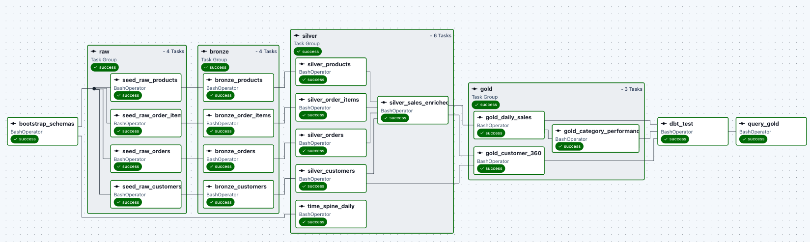
ORCHESTRATION
Airflow Runs the Batch Paths, Astronomer Makes It Enterprise-Grade
• Apache Airflow (open source) schedules and chains this project’s dbt and Spark batch builds — airflow/dags/
• March 2025: IBM + Astronomer announced “Astronomer with IBM” — an OEM partnership embedding Astronomer’s managed Astro platform into IBM’s data & AI stack
– Astronomer is the company behind Apache Airflow — used by 15,000+ data engineering teams
– Adds enterprise scalability, security, support, and hybrid-cloud deployment resiliency on top of open-source Airflow
• Complements IBM Databand — observability that monitors Airflow, DataStage, and StreamSets pipelines
watsonx.data — Medallion Lakehouse
16 / 20

Slide 19
DECISION GUIDE
dbt vs. Spark vs. DataStage vs. Confluent
Dimension | dbt | Spark | DataStage | Confluent
Language | SQL + Jinja | Python (PySpark) | No-code visual canvas | Flink SQL
Batch or streaming | Batch | Batch/Stream | Batch/Stream | Streaming
Compute | Pushed to Presto/Spark | Spark cluster | Pushed to Presto (lakehouse connector) | Flink cluster
Best for | SQL analytics engineering, tests + lineage for free, starter | Heavy ETL, ML feature prep, huge joins | Governed, audited, visual ETL | Low-latency, continuous pipelines
Cost model | Free & open source | watsonx.data Spark/Gluten | watsonx.data integration - RU Base | OSS self-hosted or RU / Confluent Cloud
Learning curve | Low (SQL-first teams) | Higher (Spark APIs) | Low (visual) | Higher (streaming concepts)
watsonx.data — Medallion Lakehouse
17 / 20

Slide 20
THE CONSTANT
Presto: The One Query Surface Across All Four Paths
dbt Gold
BI Tools
Cognos · Power BI · Tableau
Spark Gold
Presto / Presto C++ / GPU
Federated ANSI SQL
DataStage Gold
Ad-hoc SQL
Confluent Gold
Analysts, JDBC / ODBC
Prestissimo (Presto C++) is GA, ~2–3× faster than Presto Java — the same Velox substrate as Gluten-accelerated Spark. Tech Preview Nvidia GPU Query support
watsonx.data — Medallion Lakehouse
18 / 20

Slide 21
FULL PICTURE
Reference Architecture — All Four Paths, One Lakehouse
dbt
Seeds/CSV
Bronze
Silver
Gold
Spark
Object store
Bronze
Silver
Gold
DataStage
Sources
Bronze
Silver
Gold
Confluent
Flink→Silver
Gold (Spark/DS)
Kafka/Topic
watsonx.data — Iceberg Catalog
One catalog · queried by Presto · orchestrated by Airflow (batch) · consumed by BI & ML
watsonx.data — Medallion Lakehouse
19 / 20

Slide 22
WRAP-UP
Key Takeaways
• One governed Iceberg lakehouse, four ways in — pick the tool that fits your team, not the other way around
• dbt is free and SQL-first; Spark adds Python/ML muscle; DataStage adds no-code governance easy for onboarding; Confluent adds real-time
• The industry — Databricks, Snowflake — is converging on the same event-driven pattern Confluent already delivers here
• Presto is the constant: one federated query surface over everything, for every BI tool and analyst
• Orchestration matures too: open-source Airflow today, OEM Astronomer’s enterprise layer when you need it
• start with dbt or Datastage (easy to adopt by teams, using AI Agents for dbt or watsonx.data integration)
• Upsell Databand (watsonx.data integration, to observe, dbt, Airflow, Python, Datastage, Spark, ….)
NEXT STEPS
Try any path yourself in the workshop repo — questions welcome anytime. https://aseelert.github.io/ibmas-watsonxdata-dbt
Alexander Seelert · IBM Customer Success Engineer · alexander@de.ibm.com
watsonx.data — Medallion Lakehouse
20 / 20

